Slide 1
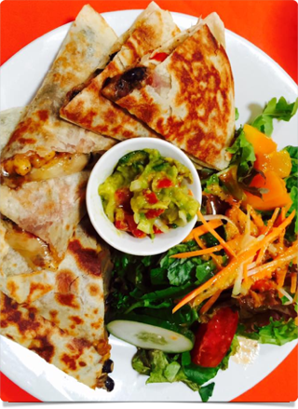
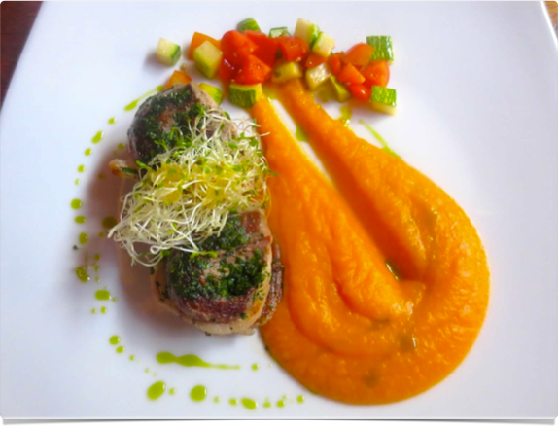
Digital Humanities
How Students Become Curators

Slide 2
Outline
Research Challenges
Initial Foray into Digital Humanities
DH as a Pedagogical Tool
Recent DH Projects: Food as Course Theme
Writing and Research Benefits of DH
Unanticipated Benefits
Ongoing Challenges

Slide 3
Research Challenges
Relationship between Library & English (one-shot)
Students as passive researchers
Limited audience for papers

Slide 4
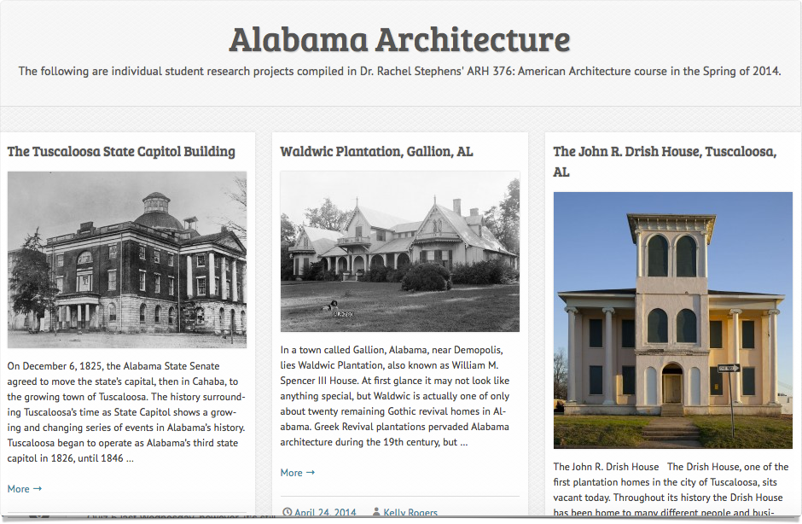

Slide 6
The Exhibition: Preparation & Opening

Slide 7
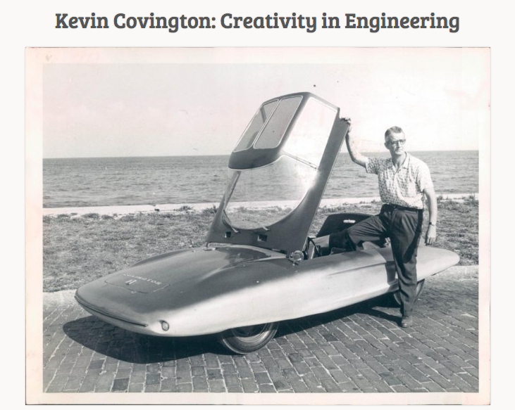
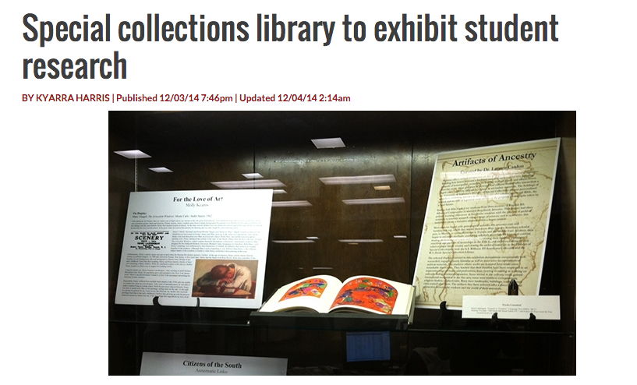
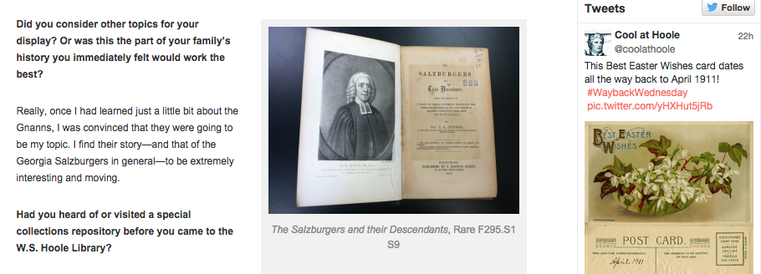
Project Outcomes & Recommendations
Students showcased their work and received recognition
Students found a point of entry into an ambitious research project
Students and faculty involved gained public exposure for our work.
Students contacted professionals to learn about their families

Slide 8
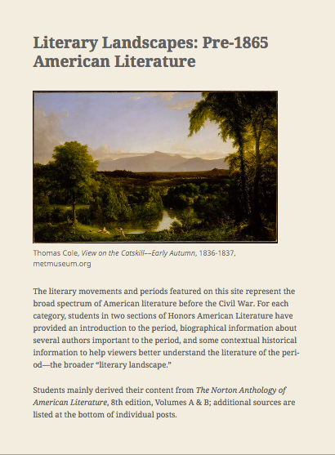
DH as A Pedagogical Tool
Students become curators
Students gain professional experience
Students learn technical skills
Students envision themselves as part of a community
Faculty network with other programs and resources

Slide 9
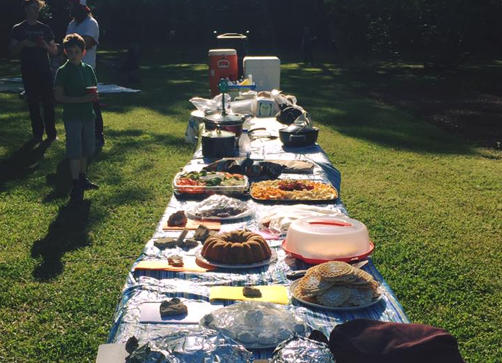
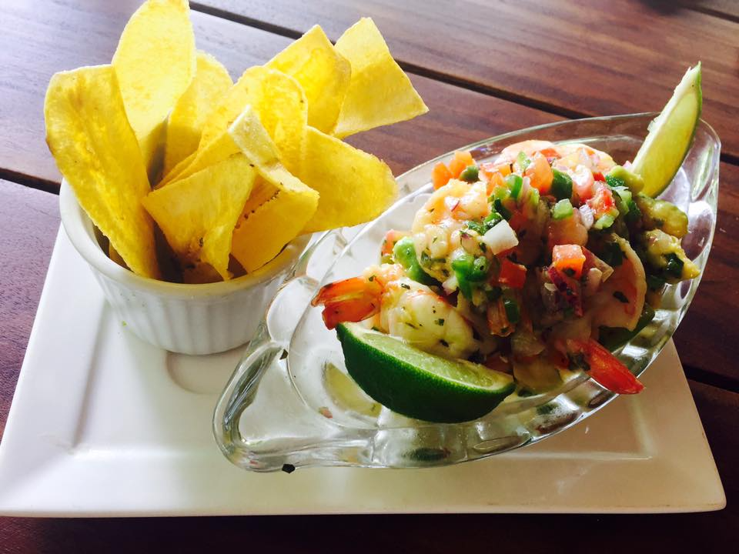
Food as a Writing Class Theme
Pleasure & Bonding:
Discussion
Multi-sensory Experience:
Description

Slide 10
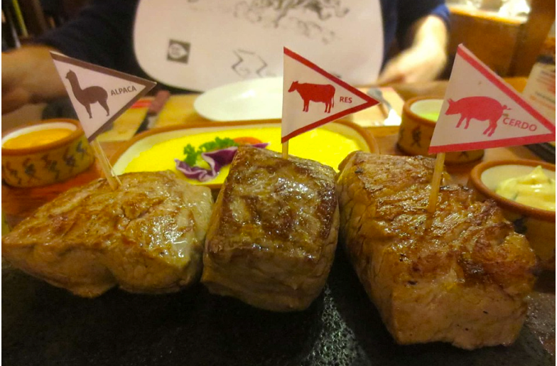
Nostalgia: Reflection
Topical Debates: Rhetoric
Culture: Research

Slide 11
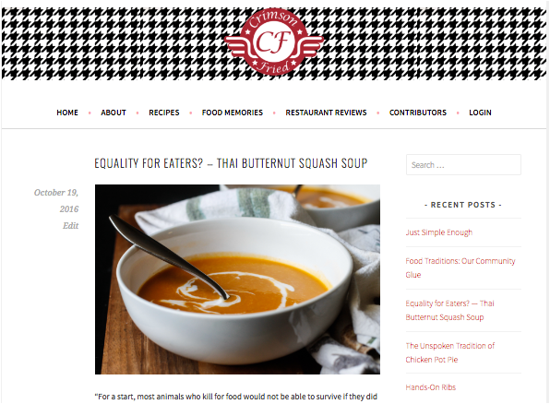

Slide 12
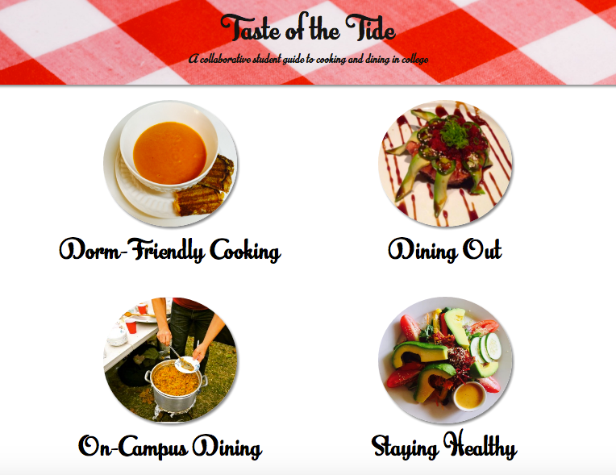

Slide 13
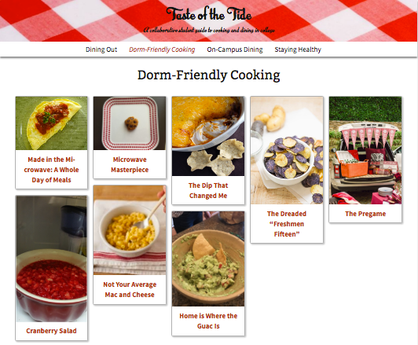

Slide 14
Writing Skills
Audience
Rhetoric
Prose style/diction
Presentation
Organization

Slide 15
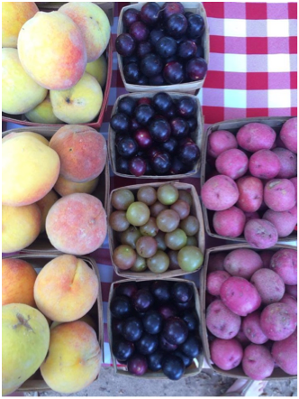
Diction & Presentation
Bright red, juicy, succulent strawberries pop from their vines, deep indigo orbs drop from the stems of the blueberry bushes, and snake green rinds are sliced open to reveal speckled, pale pink watermelon. When the leaves begin to drop and the Earth falls into a world of deep yellows, burgundies, and browns, gorging pumpkins, feathery fennel shoots, crunchy apples, and fluffy green kale are ready to be plucked for favorite autumnal dishes.

Slide 16
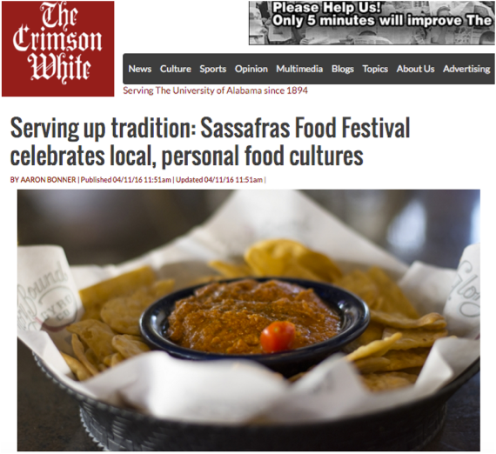
Unanticipated Benefits
Social Media and Promotion
On-campus networking
Community-wide networking
Student professionalization

Slide 17
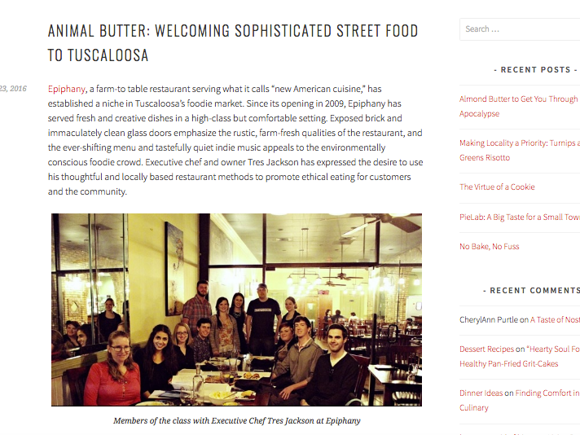

Slide 18
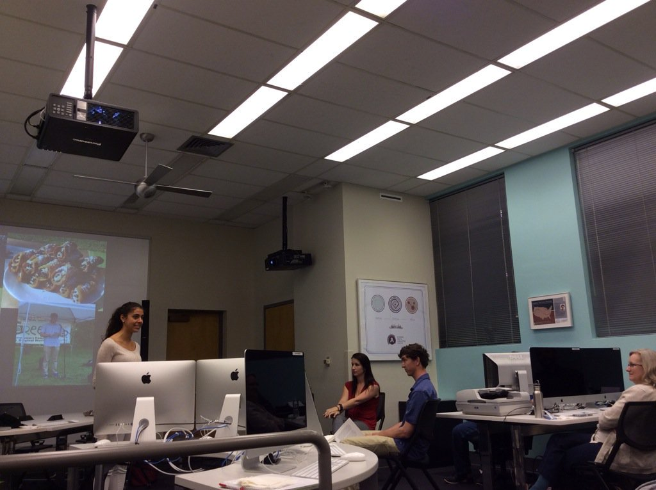

Slide 19
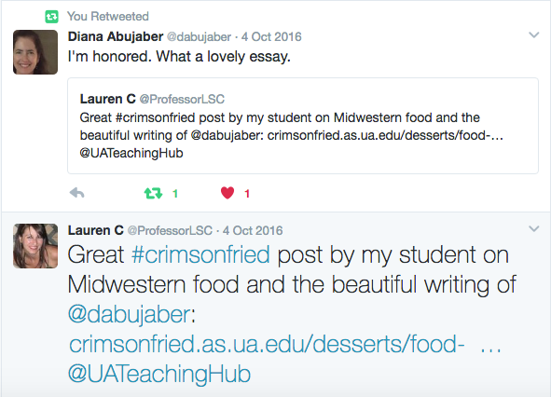
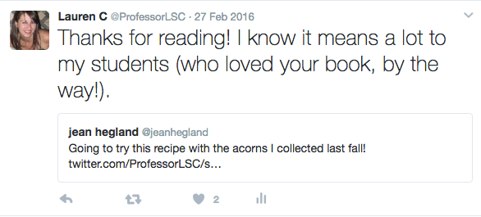

Slide 20
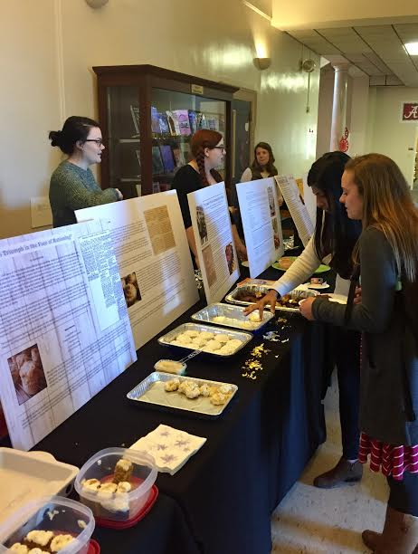
Ongoing Challenges & Considerations
IRB concerns
Concerns about audience
Concerns about workload
Concerns about coherence
Concerns about continuity

